Slide 1
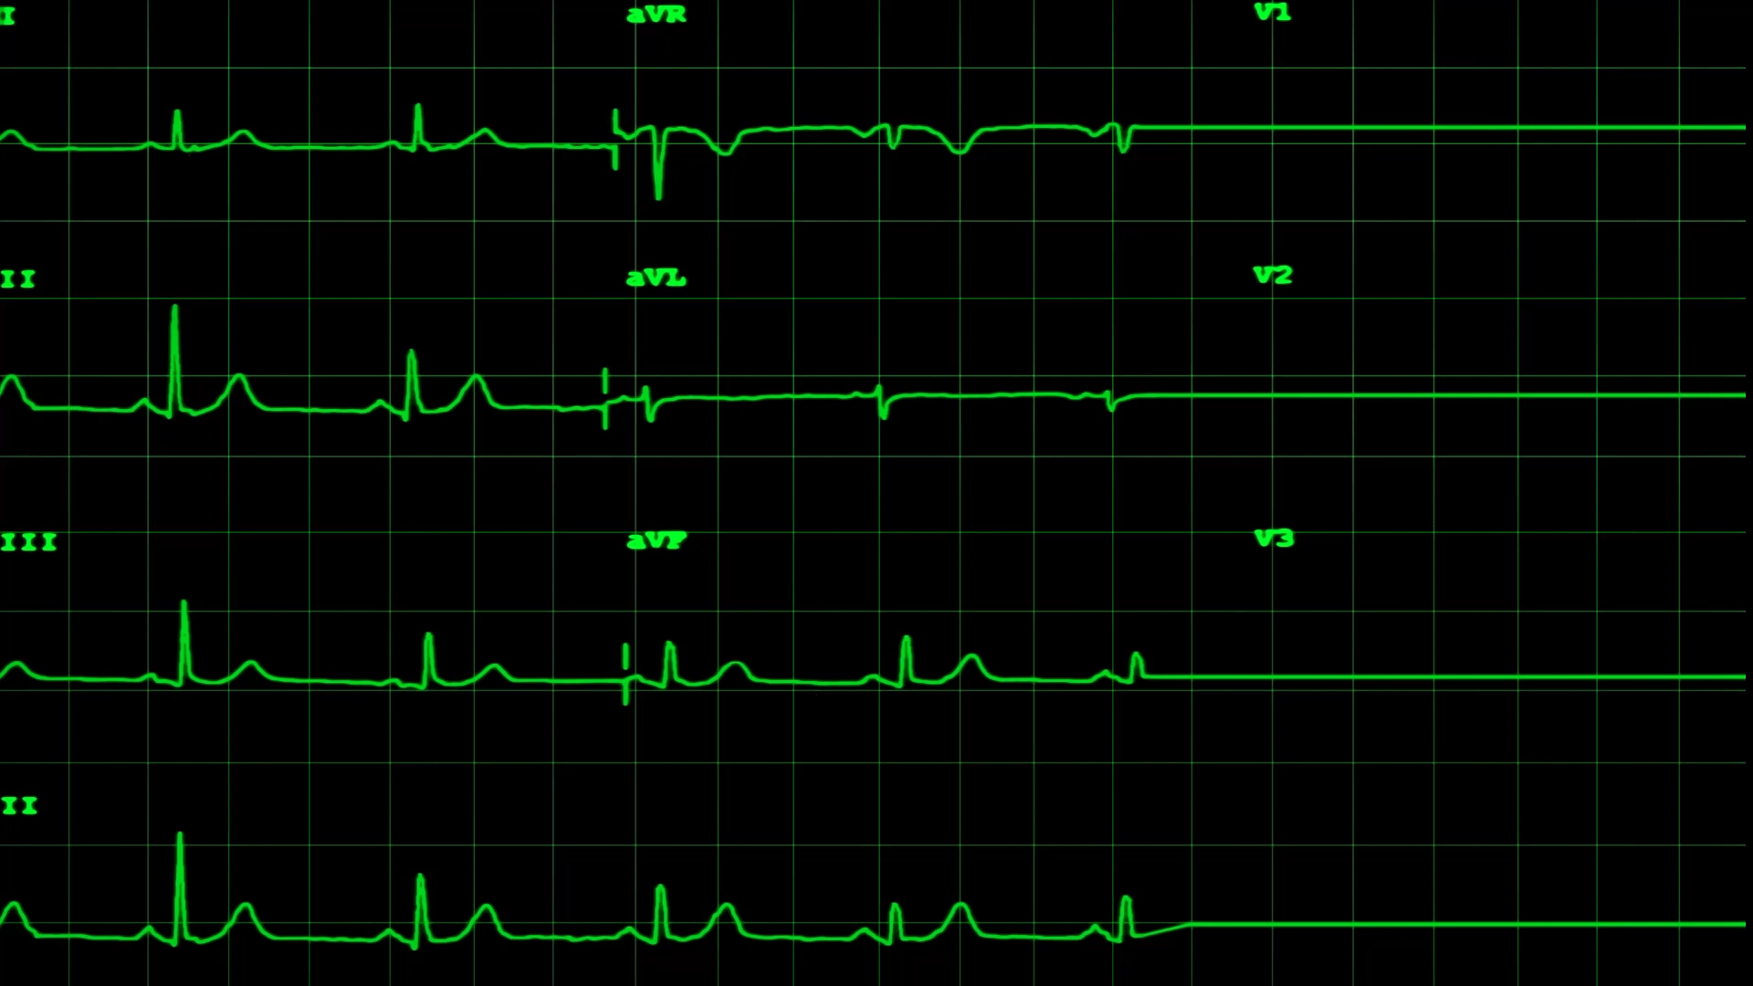
Incorporating Spatial Autocorrelation in DasymetricMapping Analysis: A Hierarchical Poisson Spatial Disaggregation Regression Model (HPSDRM)
Bowen He
Civil and Environmental Engineering, Vanderbilt University

Slide 2
Content
Introduction
Methodology/Research Design
Core R package: Template Model Builder (TMB)
Regularized Regression Analysis: (1) LASSO; (2) Ridge; (3) Elastic Net
Moran’s I Analysis: tract/block population in Davidson County, Nashville
Hierarchical Poisson Spatial Disaggregation Regression Model (HPSDRM)
Simulation Studies: (1) Conditional AutoRegressive Model (CAR); (2) Integrated Matérn field and CAR;
Case Study: population modeling in the Davidson County, Nashville
Comparative Analysis:
(1) Ordinary least Squares (OLS);
(2) Intelligent Dasymetric Mapping (IDM);
(3) Areal Weighting Mapping (AWM);
(4) Hierarchical Poisson Spatial Disaggregation Regression Model (HPSDRM)

Slide 3
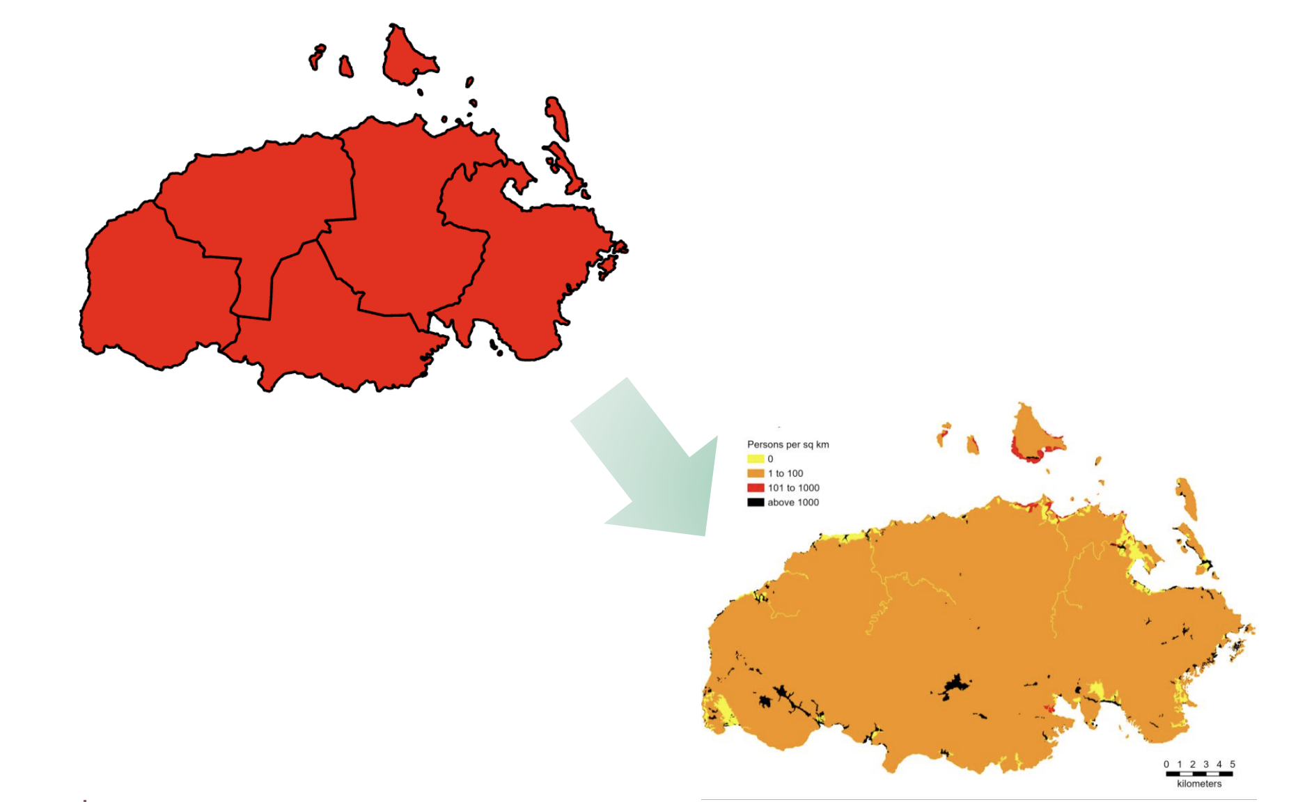
Introduction
Traditionally, population data are obtained through censuses survey and then aggregated up to various levels of administrative units such as census tracts.
Thus, detailed information on the spatial distribution of population is always unrevealed and an unrealistic impression that there are no spatial variations or non-stationarities within each administrative units is often provoked (Mennis, 2003; Wu & Murray, 2005).
The modifiable areal unit problem (MAUP) that is a source of spatial statistical bias rises and severely affect the spatial data analysis results by mistakenly overestimating or underestimating the spatial data corresponding to the area or the unit of interest that is finer than the observational aggregated data (Openshaw, 1983).
Dasymetric mapping approach is a cartographic technique that recently experienced a renewed interest because of the rapid progress in computation algorithm, Geographic Information System (GIS), and remote sensing technologies (Mennis, 2009; Petrov, 2012).
The technique uses information such as land cover types to redistribute observed areal aggregated data to finer spatial scales which is more suitable for various purposes like environmental justice analyses and hazard mitigation efforts evaluation since the original spatial interpretation of the demographic data in the aggregated scale is often not aligned well with the spatial scale of the hazard of interest.

Slide 4
Methodology/Research Design
Simulation Study
Case Study
Comparative Study
Matérn field model
HPSDRM dasymetric
population in Nashville
aggregated in blocks
HPSDRM
HPSDRM experiment
Performance metrics:
RMSE, R², MAE
OLS
IDM
Leroux CAR
area prior model
Decennial block
population data
In Nashville
AWM
Comparative
Analysis
Test
Application

Slide 5
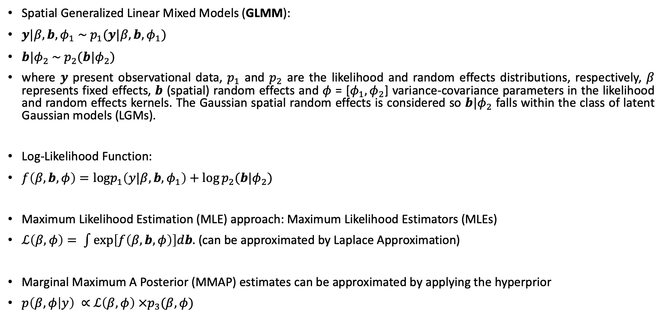
Core R Package: Template Model Builder (TMB)
Spatial Generalized Linear Mixed Models (GLMM):
$y|β, b, φ_{1} \sim p_{1}(y|β, b,φ_{1})$
$b|φ_{2} \sim p_{2}(b|φ_{2})$
where $y$ present observational data, $p_{1}$ and $p_{2}$ are the likelihood and random effects distributions, respectively, $β$ represents fixed effects, $b$ (spatial) random effects and $φ$ = [$φ_{1},φ_{2}$] variance-covariance parameters in the likelihood and random effects kernels. The Gaussian spatial random effects is considered so $b|φ_{2}$ falls within the class of latent Gaussian models (LGMs).
Log-Likelihood Function:
$f\left(β,b, φ\right)=logp_{1}\left(y|β, b,φ_{1}\right)+log⁡p_{2}(b|φ_{2})$
Maximum Likelihood Estimation (MLE) approach: Maximum Likelihood Estimators (MLEs)
$ℒ\left(β,φ\right)= \int{exp\left[f\left(β,b, φ\right)\right]db.}$ (can be approximated by Laplace Approximation)
Marginal Maximum A Posterior (MMAP) estimates can be approximated by applying the hyperprior
$p\left(β,φ | y\right) ∝$ $ℒ\left(β,φ\right) ×p_{3}(β,φ)$

Slide 6
Core R Package: Template Model Builder (TMB)
Inferential Method: Frequentist MMAP estimates from marginal posterior.
Laplace Approximation: Standard Gaussian approximation.
Variance Estimators:
(1) Inverse of the observed Hessian of the log-likelihood to estimate covariance of the fixed effects;
(2) Application of the law of total variance and a linearization to estimate the joint covariance of the fixed and random effects;
Inferential Sampling: Joint posterior with asymptotic normality with gaussian mode centered at the MMAP estimates and variance-covariance matrix from observed information and linearization (variance estimators).

Slide 7
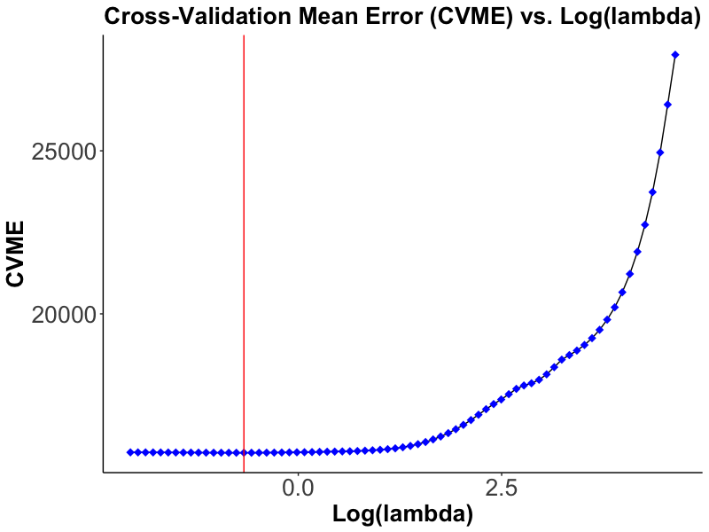
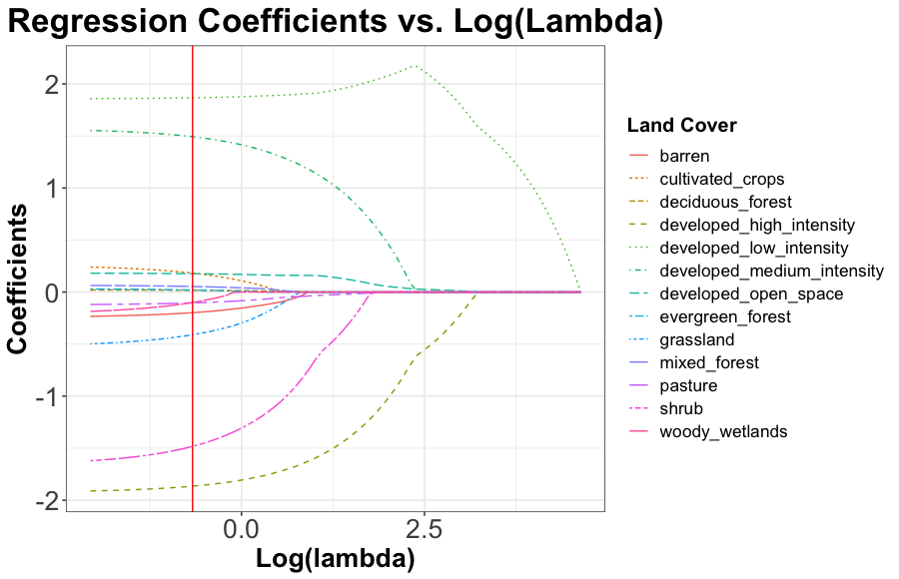
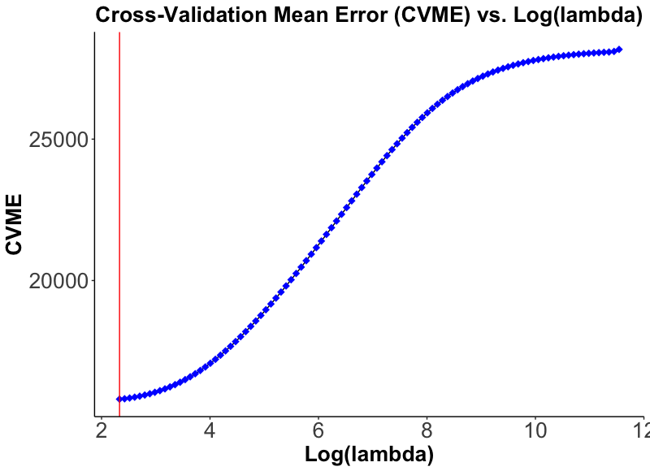
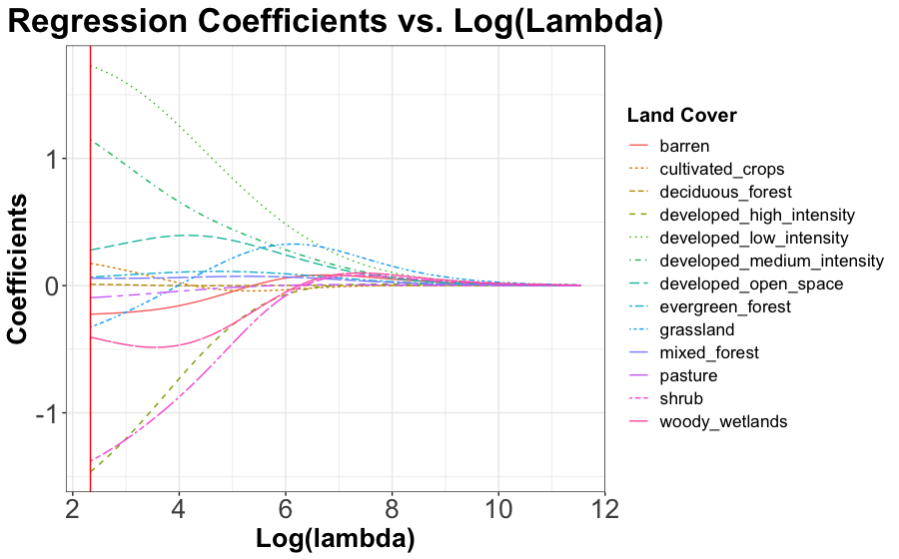
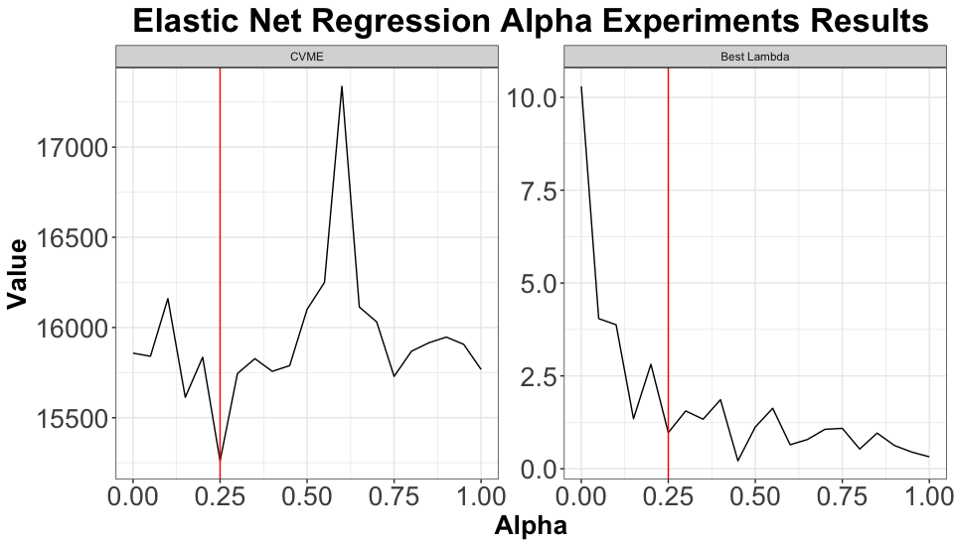
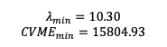
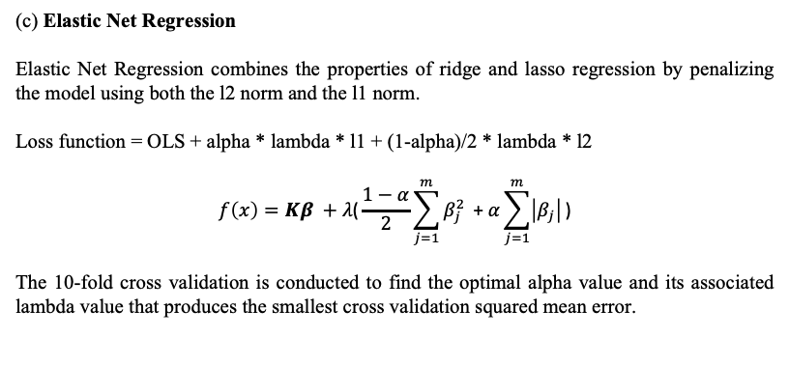
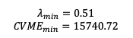
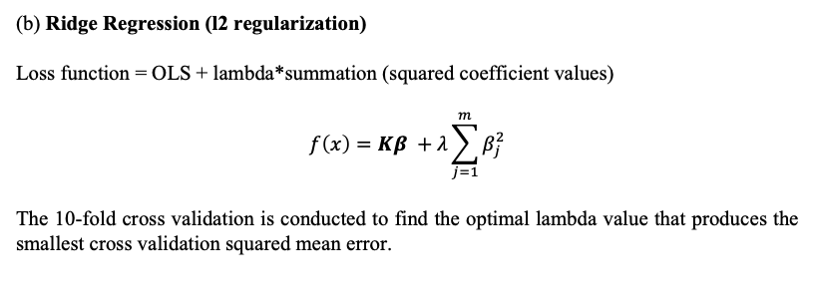
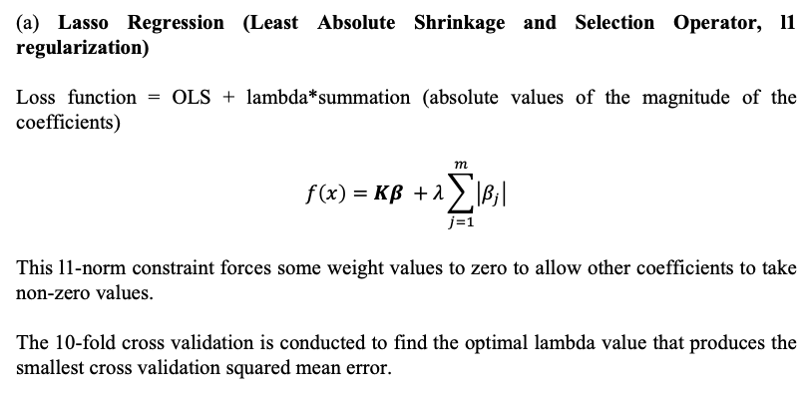
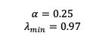
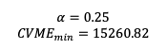
Regularized Regression Analysis
(a)
(b)
(a) Lasso Regression (Least Absolute Shrinkage and Selection Operator, l1 regularization)
Loss function = OLS + lambda*summation (absolute values of the magnitude of the coefficients)
$$f\left(x\right)=Kβ +λ\sum_{j=1}^{m}{\left|β_{j}\right|}$$
This l1-norm constraint forces some weight values to zero to allow other coefficients to take non-zero values.
The 10-fold cross validation is conducted to find the optimal lambda value that produces the smallest cross validation squared mean error.
LASSO Regression
$$λ_{min}=0.51$$
$${CVME}_{min}=15740.72$$
(c)
(d)
Ridge Regression
(b) Ridge Regression (l2 regularization)
Loss function = OLS + lambda*summation (squared coefficient values)
$$f\left(x\right)=Kβ +λ\sum_{j=1}^{m}{β_{j}^{2}}$$
The 10-fold cross validation is conducted to find the optimal lambda value that produces the smallest cross validation squared mean error.
$$λ_{min}=10.30$$
$${CVME}_{min}=15804.93$$
(e)
(c) Elastic Net Regression
Elastic Net Regression combines the properties of ridge and lasso regression by penalizing the model using both the l2 norm and the l1 norm.
Loss function = OLS + alpha * lambda * l1 + (1-alpha)/2 * lambda * l2
$$f\left(x\right)=Kβ +λ\text{(}\frac{1−α}{2}\sum_{j=1}^{m}{β_{j}^{2}}\text{ + }α\sum_{j=1}^{m}{\left|β_{j}\right|}\text{)}$$
The 10-fold cross validation is conducted to find the optimal alpha value and its associated lambda value that produces the smallest cross validation squared mean error.
$$α=0.25$$
$$λ_{min}=0.97$$
$$α=0.25$$
$${CVME}_{min}=15260.82$$

Slide 8
Linear Predictor: Land Cover Covariates Selection
(a) LASSO Regression Coefficients
(b) Ridge Regression Coefficients
(c) Elastic Net Regression Coefficients
Land cover | Coefficient
Intercept | 24.58
Developed open space | 0.18
Developed low intensity | 1.87
Developed medium intensity | 1.49
Developed high intensity | -1.87
Shrub | -1.48
Grassland | -0.41
Barren | -0.2
Cultivated crops | 0.18
Land cover | Coefficient
Intercept | 27.21
Developed open space | 0.28
Developed low intensity | 1.73
Developed medium intensity | 1.15
Developed high intensity | -1.46
Shrub | -1.38
Grassland | -0.33
Barren | -0.22
Cultivated crops | 0.17
Woody wetlands | -0.4
Land cover | Coefficient
Intercept | 24.58
Developed open space | 0.19
Developed low intensity | 1.85
Developed medium intensity | 1.50
Developed high intensity | -1.86
Shrub | -1.56
Grassland | -0.46
Barren | -0.22
Cultivated crops | 0.22
Two criterion in selecting land cover covariates: (1) positive; (2) coefficient is large; (3) least number of covariates included.
Therefore, 3 land cover predictors are included: (1) Developed low intensity (DLI); (2) Developed
medium intensity (DMI); (3) Developed open space (DOS).

Slide 9
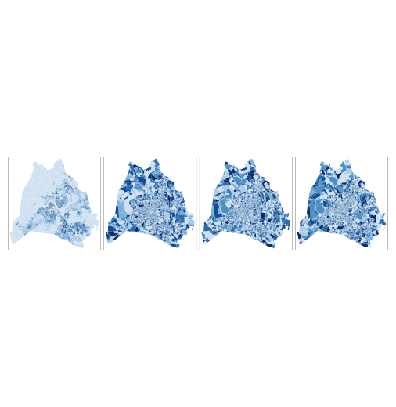
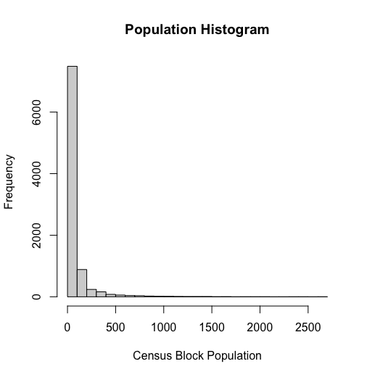
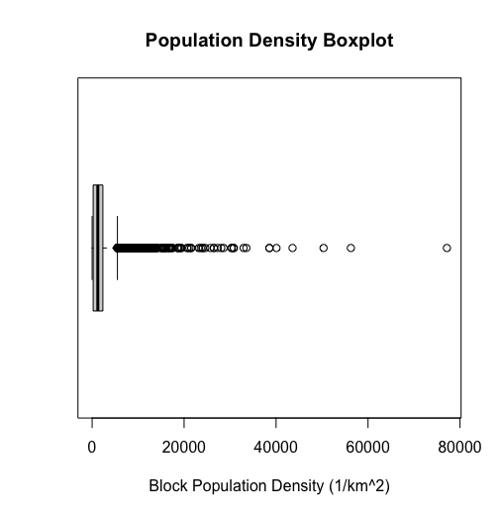
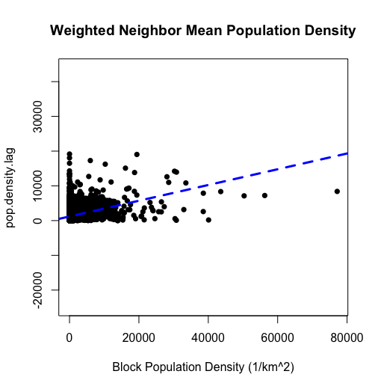
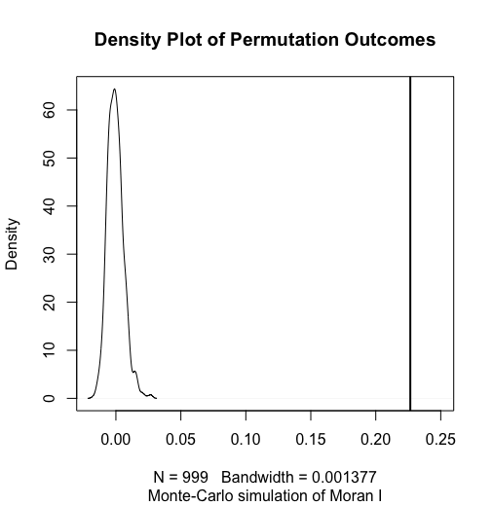
Moran’s I Analysis on Census Block Population Density Data
(a)
(b)
(e)
Visual Experiments
(e.1)
(e.2)
(e.3)
(e.4)
(c)
(d)
Null Hypothesis: population is randomly distributed across spaces.
Moran I statistic: 0.227
P-value < 2.2e-16
Conclusion: null hypothesis is rejected that population is not randomly distributed across spaces. Census blocks with higher population density tend to be neighbors with blocks that also have higher population density.

Slide 10
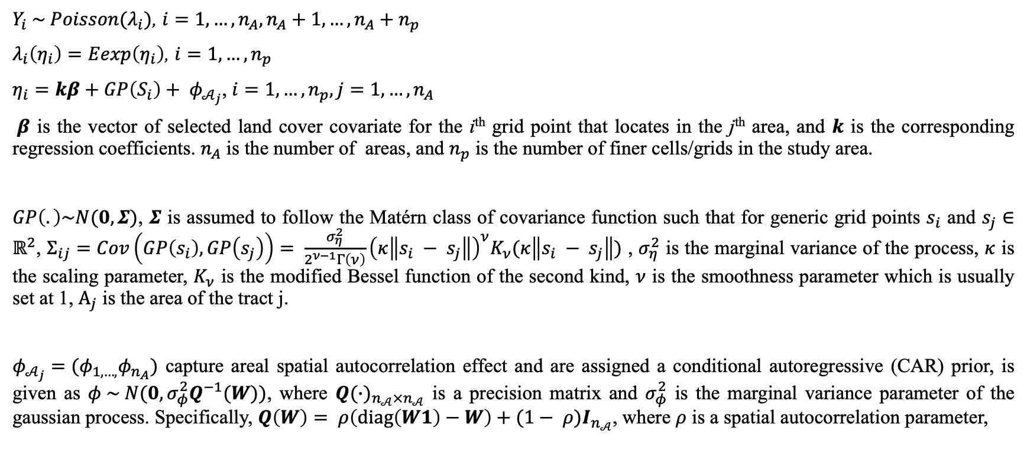
Hierarchical Poisson Spatial Disaggregation Regression Model (HPSDRM)
$Y_{i} \sim Poisson(λ_{i})$, $i=1,…,n_{A},n_{A}+1,…,n_{A}+n_{p}$
$λ_{i}\left(η_{i}\right)=Eexp\left(η_{i}\right)$, $i=1,…,n_{p}$
$η_{i}=kβ+GP\left(S_{i}\right)+ φ_{𝒜_{j}}$, $i=1,…,n_{p}, j=1,…,n_{A}$
$β$ is the vector of selected land cover covariate for the i^{th} grid point that locates in the j^{th} area, and $k$ is the corresponding regression coefficients. $n_{A}$ is the number of areas, and $n_{p}$ is the number of finer cells/grids in the study area.
$GP\left(.\right)\sim N(0, Σ)$, $Σ$ is assumed to follow the Matérn class of covariance function such that for generic grid points $s_{i}$ and $s_{j}∈ℝ^{2}$, $Σ_{ij}=Cov\left(GP\left(s_{i}\right), GP\left(s_{j}\right)\right)= \frac{σ_{η}^{2}}{2^{ν−1}Γ\left(ν\right)}{\left(κ\left\|s_{i} − s_{j}\right\|\right)}^{ν}K_{ν}(κ\left\|s_{i} − s_{j}\right\|)$ , $σ_{η}^{2}$ is the marginal variance of the process, $κ$ is the scaling parameter, $K_{ν}$ is the modified Bessel function of the second kind, $ν$ is the smoothness parameter which is usually set at 1, $Α_{j}$ is the area of the tract j.
$φ_{𝒜_{j}}=(φ_{1,…,}φ_{n_{A}})$ capture areal spatial autocorrelation effect and are assigned a conditional autoregressive (CAR) prior, is given as $φ \sim N(0, σ_{φ}^{2}Q^{−1}(W))$, where ${Q(∙)}_{n_{𝒜}×n_{𝒜}}$ is a precision matrix and $σ_{φ}^{2}$ is the marginal variance parameter of the gaussian process. Specifically, $Q\left(W\right)= ρ\left(diag\left(W1\right)−W\right)+(1− ρ)I_{n_{𝒜}}$, where $ρ$ is a spatial autocorrelation parameter,

Slide 11
Simulation Experiments Area Configuration
(a)
(b)
Area Observations (30*30)
Grids Simulation (150*150)
1
y
0
0
1
0
1
x

Slide 12
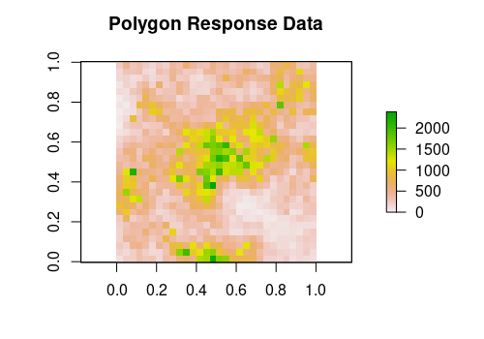
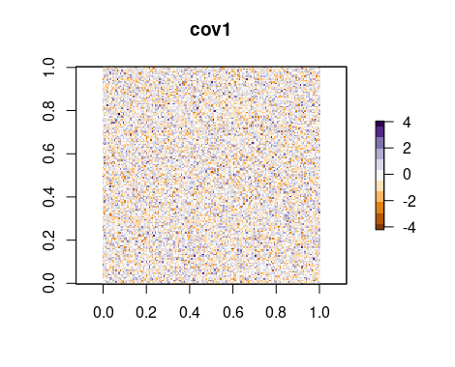
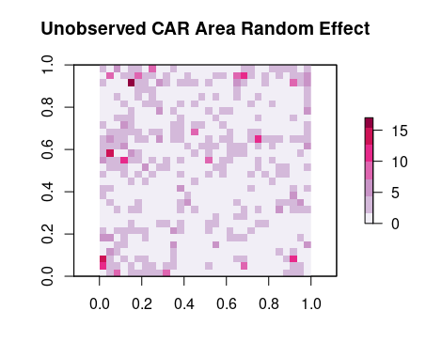
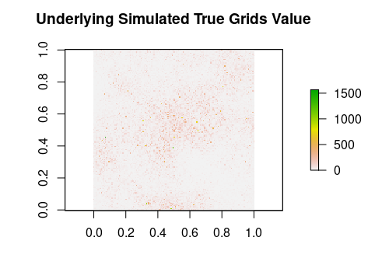
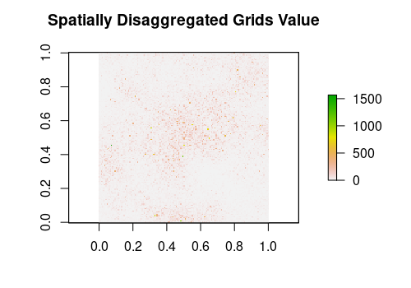
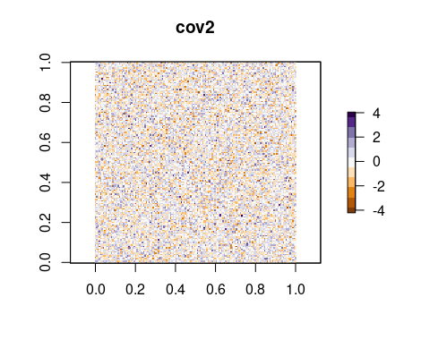
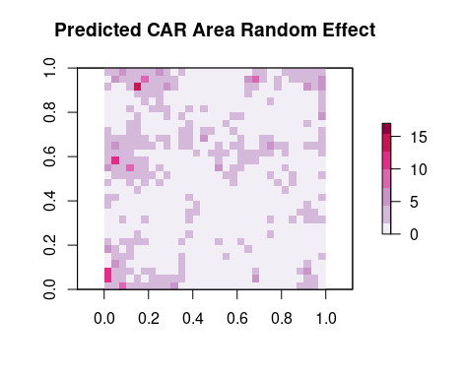
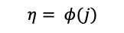
(Hierarchical) Poisson Spatial Disaggregation Regression (HPSDRM) Simulation Model Set Up
Matérn Field Model
+
Leroux CAR Model
$$η= β_{0}+cov1∗β_{1}+cov2∗β_{2}+s(i)$$
Covariances
$$η= φ(j)$$
(a)
(b)
(c.1)
(a)
(d)
(e)
(c.2)
(b)

Slide 13
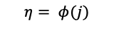
Leroux CAR Model Simulation Experiment Setup
Leroux CAR Model
$$η= φ(j)$$
(a)
Lambda (mixing parameter) = 0.7
Var (marginal variance) = 3
(b)
Hyperpriors Summary
Parameter | Family | Prior parameters
Logit-Lambda | Gaussian | mean = logit(0.7), sd = 1
Precision | Gamma | shape = (1/3)^2, scale = 3

Slide 14
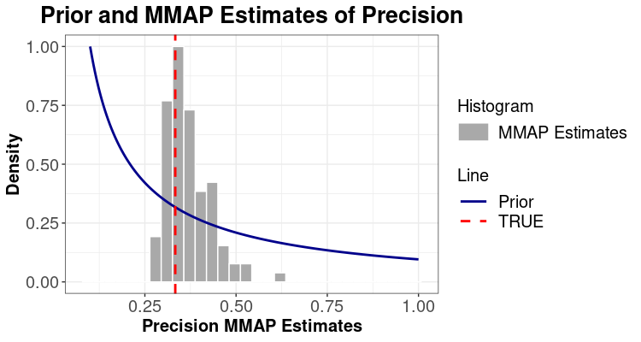
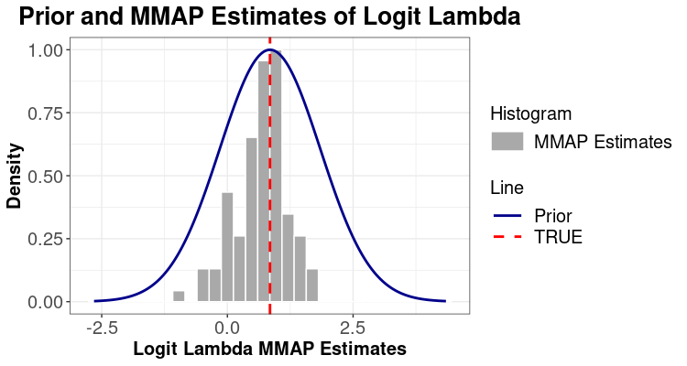
Leroux CAR experiment results-Hyperparameters MMAP Estimations
(a)
(b)

Slide 15

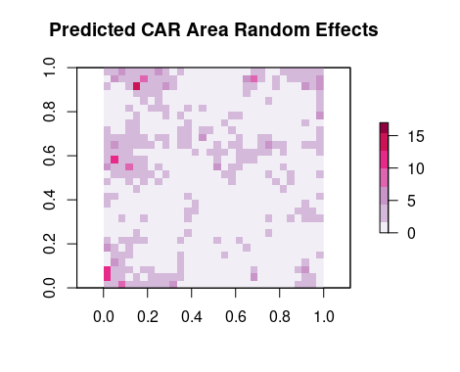
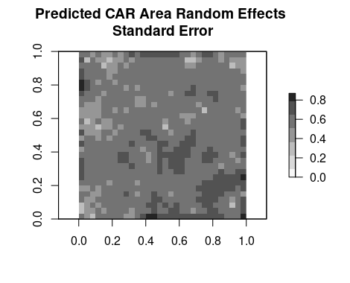
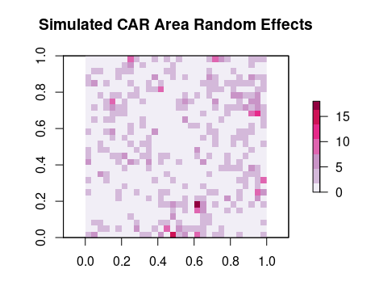
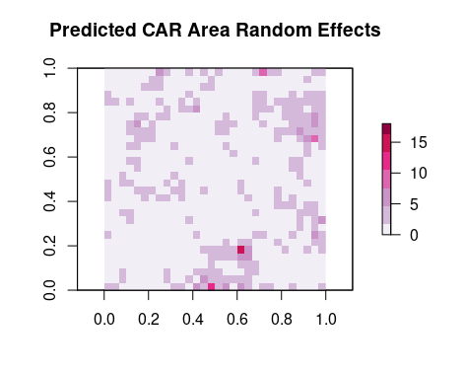
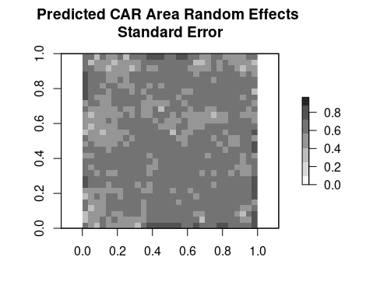
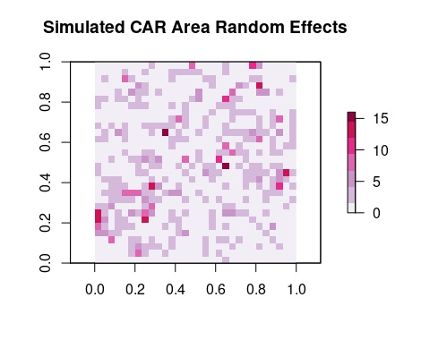
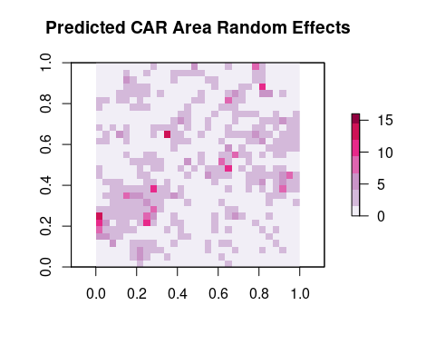
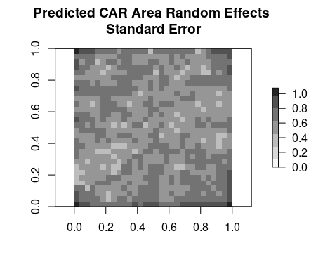
CAR experiment results- Model Interpolation
(a)
(a.1)
(a.2)
(b)
(b.1)
(b.2)
3 realizations visualizations
(c)
(c.1)
(c.2)

Slide 16
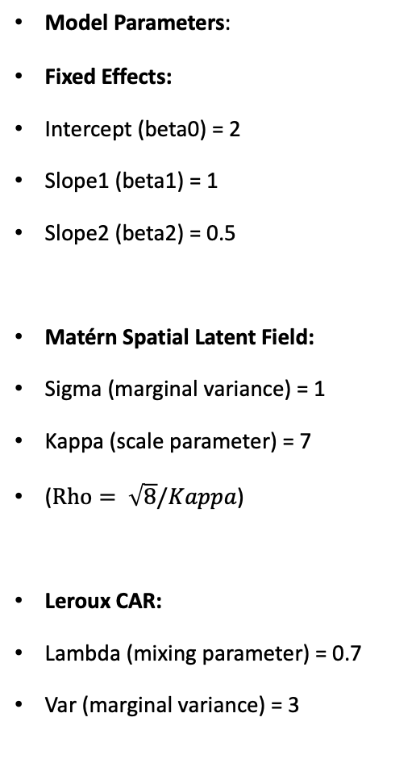
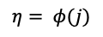
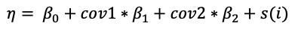
HPSDRModel Simulation Experiment Setup
Model Parameters:
Fixed Effects:
Intercept (beta0) = 2
Slope1 (beta1) = 1
Slope2 (beta2) = 0.5
Matérn Spatial Latent Field:
Sigma (marginal variance) = 1
Kappa (scale parameter) = 7
($Rho= \sqrt{8}/Kappa$)
Leroux CAR:
Lambda (mixing parameter) = 0.7
Var (marginal variance) = 3
Matérn Field Model
+
Leroux CAR Model
$$η= β_{0}+cov1∗β_{1}+cov2∗β_{2}+s(i)$$
Covariances
$$η= φ(j)$$
(a)
(b)
(c.1)
(a)
(d)
(e)
(c.2)
(b)
(Hyper)Priors Summary
Parameter | Family | Prior parameters
Intercept | Gaussian | mean = 2, sd = 1
Slope1 | Gaussian | mean = 1, sd = 1
Slope2 | Gaussian | mean = 0.5, sd = 1
Log-Sigma (marginal variance) | Gaussian | mean = 0, sd = 1
Log-Rho (range) | Gaussian | mean = -0.9, sd = 1
Logit-Lambda (mixing parameter) | Gaussian | mean = logit(0.7), sd = 1
Precision | Gamma | shape = (1/3)^2, scale = 3

Slide 17
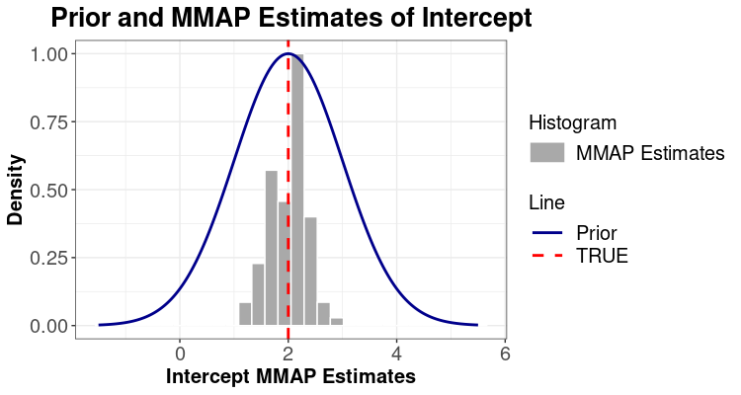
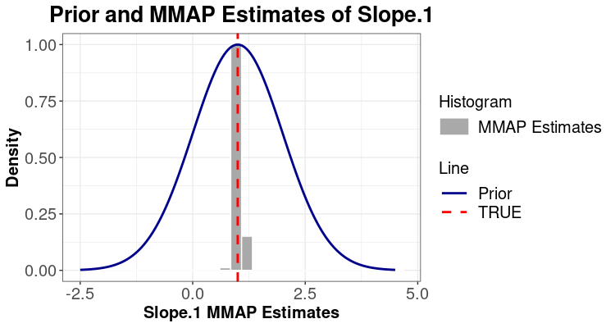

HPSDRModel with both Matérn Spatial field and Leroux CAR Prior-Model Estimation (Fixed Effects MMAP Estimates)
(a)
(b)
(c)

Slide 18
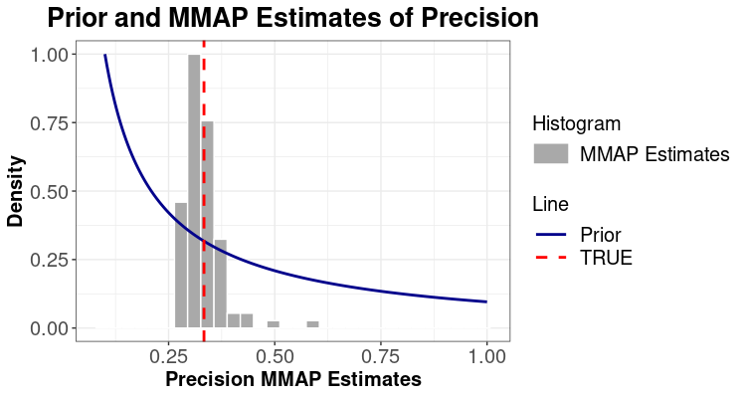
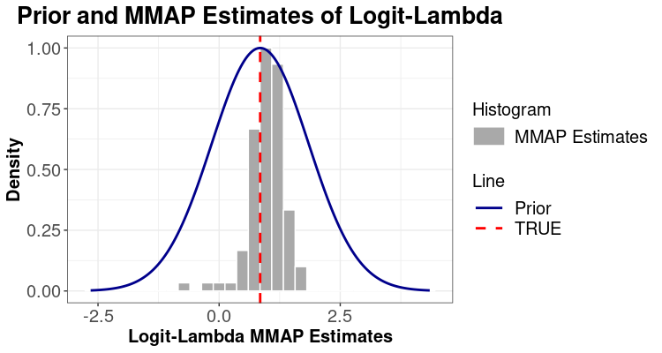
HPSDRModel with both Matérn Spatial field and Leroux CAR Prior-Model Estimations (Leroux CAR prior Hyperparameters MMAP Estimates)
(a)
(b)

Slide 19
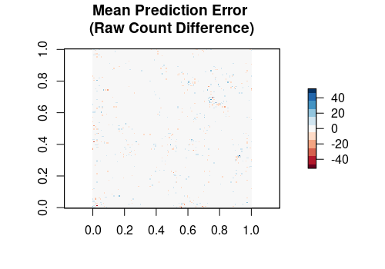
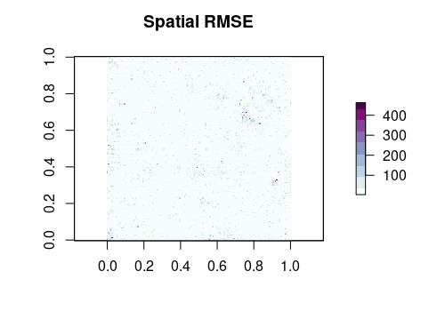
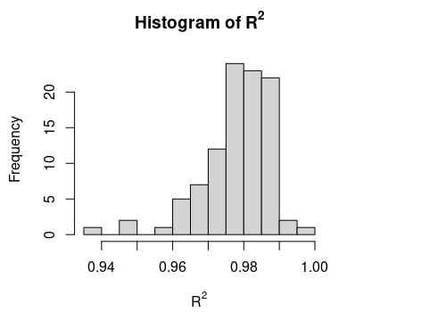

HPSDRModel with both Matérn field and Leroux CAR prior-Model Interpolation Assessment
Summary of Simulated Grids
Value of 100 Realizations
Min: 0.00
1st QU: 2.00
Median: 7.00
Mean: 33.98
3rd QU: 24.00
Max: 124060.00
(a)
(b)
(c)
(d)

Slide 20







HPSDRModel with both Matérn Spatial field and Leroux CAR prior-Simulated Realization Visualizations
(a)
(b)
(c)
RMSE: 12.64
R²: 0.99
MAE: 4.83
(d)
(e)
(f)
(g)

Slide 21

Case Study: Population in Davidson County, Nashville

Slide 22



Case Study: Population in Davidson County, Nashville
Land Cover Predictors
(a)
(c.1)
(c.2)
(c.3)
Target resolution:
30*5m * 30*5m cell grids
(b)
(Hyper)Priors Summary
Parameter | Family | Prior parameters
Intercept | Gaussian | mean = 0, sd = 2
LC (DOS, DLI, DMI) | Gaussian | mean = 0, sd = 1
Range (Matérn) | PC | min = 1.5, prob = 0.01
Sigma (Matérn) | PC | max = 0.25, prob = 0.01
Logit Lambda (CAR) | Gaussian | mean = logit(0.5), sd = 15
Precision (CAR) | Gamma | shape = 1, scale = 2

Slide 23




Dasymetric Mapping Posterior Results: Mean Prediction Decompositions
(a)
(b)
CRS:
proj = utm
zone = 16
datum = NAD83
units = km
ellps = GRS80
towgs84 = 0,0,0
(c)
(d)

Slide 24








Model Fitting Posterior Summary: Model (Hyper)Parameters Posterior Samples
Model Summary
Model (Hyper)Parameters Priors and Asymptotic Posterior Samples
(a)
(c.1)
(c.2)
Model Parameters
Fixed Effects | Mean | Std. Error
Intercept | -0.46 | 0.47
DOS | 0.13 | 0.03
DLI | 0.17 | 0.02
DMI | 0.22 | 0.03
Log-Sigma | -2.59 | 1.29
Log-Rho | 1.80 | 0.76
Logit-Lambda | -7.25 | 5.23
Log-Precision | 0.37 | 0.12
Objective Function-Negative Log Likelihood (NLL) | -11089.45 | NA
Priors-Negative Log Likelihood (NLL Priors) | -11967.34 | NA
Out Sample (block) Performance |  | Value
R² |  | 0.70
RMSE |  | 99.26
MAE |  | 42.39
Pearson |  | 0.84
Spearman |  | 0.75
Log-Pearson |  | 0.75
(c.3)
(c.4)
(b)
(c.5)
(c.6)

Slide 25





Uncertainty Predictions
Realizations Visualizations
(b.1)
(b.2)
(a)
(b.3)
(b.4)

Slide 26

Intelligent Dasymetric Mapping (IDM)
Three IDM sampling methods:
(1) ‘containment’ method: samples those source zones that are wholly contained within an individual ancillary class;
(2) ‘centroid’ method: selects those source zones that have their centroids contained within an individual ancillary class;
(3) ‘percent cover’ method allows the user to set a threshold percentage value and then selects those source zones whose area of occupation of a single ancillary class is equal to or exceeds that threshold (Mennis and Hultgren, 2006).
Estimated density of ancillary class can be computed:
$D_{c}= \sum_{s=1}^{m}{y_{s}}/\sum_{s=1}^{m}{A_{s}}$
where $D_{c}$ is the estimated density of the ancillary class $c$, $y_{s}$ is the count or value of the sampled source zones, $A_{s}$ is the area of the sampled source zones that represent the ancillary class $c$, $m$ is the total number of sampled source zones that represent the ancillary class $c$.
For these ancillary classes $c$ that have been successfully sampled, their densities can be computed and the estimated count for a given target zone can thus be obtained:
$y_{t}= y_{s} \left(\frac{A_{t}D_{c}}{\sum_{tεs}{(A_{t}D_{c})}}\right)$
For certain ancillary classes when no source zones can meet the sampling criterion to represent them, the “refined” areal weight is first applied to derive their temporary count:
$y_{t(u)}=\left(y_{s}− \sum_{t\left(k\right)∈s}{D_{k}A_{t\left(k\right)}})(A_{t\left(u\right)}/\sum_{t(u)∈s}{A_{t(u)}}\right)$
where $y_{t(u)}$ is the temporary estimated count of the target zone associated with unsampled ancillary class $u$, $D_{k}$ is the estimated density of known class $k$ within the source zone $s$, $A_{t\left(k\right)}$ is the area of the target zone associated with known class $k$, and $A_{t\left(u\right)}$ is the area of the target zone associated with unknown class $u$. Once the temporary estimated count of the unknown ancillary class 𝑢 is calculated for each target zones in the entire data set, the estimated density of ancillary class 𝑢 can thus be derived:
$D_{u}= \sum_{t\left(u\right)=1}^{p}{y_{t(u)}}/\sum_{t\left(u\right)=1}^{p}{A_{t(u)}}$
${Pop}_{i}= {Pop}_{j}×\frac{D_{k}∗A_{i}}{\sum_{i∈j}{(D_{k}∗A_{i})}}$, the sum of all the redistributed grids’ population still equals to the source zone’s original total population:

Slide 27

Ordinary Least Squares (OLS) and Areal Weighting Mapping (AWM)
OLS
AWM
Ordinary Least Squares (OLS):
$Y_{j}= LC′∗β$
$Y_{j}$ is the tract population
$LC= \left(\begin{matrix}{LC}_{1} \\ … \\ {LC}_{n}\end{matrix}\right)$ is the selected significant land cover covariates value based on the linear regularized analysis results, $β= \left(\begin{matrix}k_{1} \\ … \\ k_{n}\end{matrix}\right)$ is the land covariates coefficients calculated based on the OLS.
After the coefficient between each land cover type and population is estimated, the population in each grid can be redistributed based on the relative importance of the grids’ land cover in the source zones while remains the pycnophylactic property (volume conservation) that the sum of all the redistributed grids’ population still equals to the source zone’s original total population:
${Pop}_{i}= {Pop}_{j}×\frac{{coeff}_{k}∗A_{i}}{\sum_{i∈j}{({coeff}_{k}∗A_{i})}}$
where ${Pop}_{i}$ is the estimated number of persons in the grid $i$, ${Pop}_{j}$ is the estimated number of persons in the tract $j$ that the grid $i$ resides in, ${coeff}_{k}$ is the estimated linear regression coefficient for land cover $k$ and $A_{i}$ is the area of the grid $i$ that the land cover $k$ resides in.
Areal Weighting Mapping (AWM)
The Areal Weighting Mapping (AWM) method assigns a proportion of the population to the target area relative to the percentage of its area within the source geographic unit that it belongs to (Holifield et al., 2017). The core assumption of this traditional mapping approach is that the population is homogeneously spatially distributed within the source geographic unit like census tracts.

Slide 28



Comparative Analysis
CRS:
proj = utm
zone = 16
datum = NAD83
units = km
ellps = GRS80
towgs84 = 0,0,0
(a)
(b)
(c)
(d)

Slide 29



Out Sample Block Population Performance
(a)
(b)
Pearson: 0.81
Spearman: 0.73
Log-Pearson: 0.73
Pearson: 0.65
Spearman: 0.61
Log-Pearson: 0.64
(c)
(d)
Pearson: 0.70
Spearman: 0.65
Log-Pearson: 0.67
Pearson: 0.84
Spearman: 0.75
Log-Pearson: 0.75

Slide 30
Comparative Analysis-Performance Metrics
Model/Metrics | OLS | IDM | AWM | HPSDRM
R²(%) | 64 | 12 | 33 | 70
RMSE | 108.41 | 169.73 | 148.58 | 99.26
MAE | 46.58 | 65.34 | 60.13 | 42.39

